Slide 1



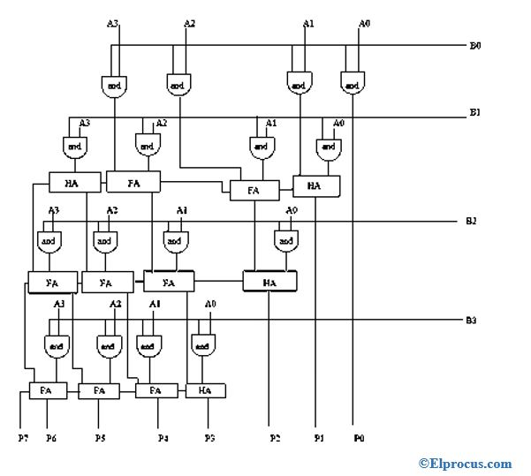
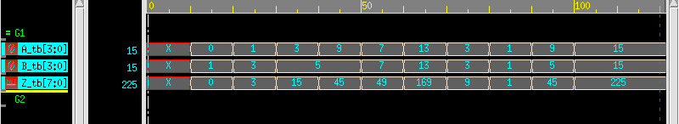
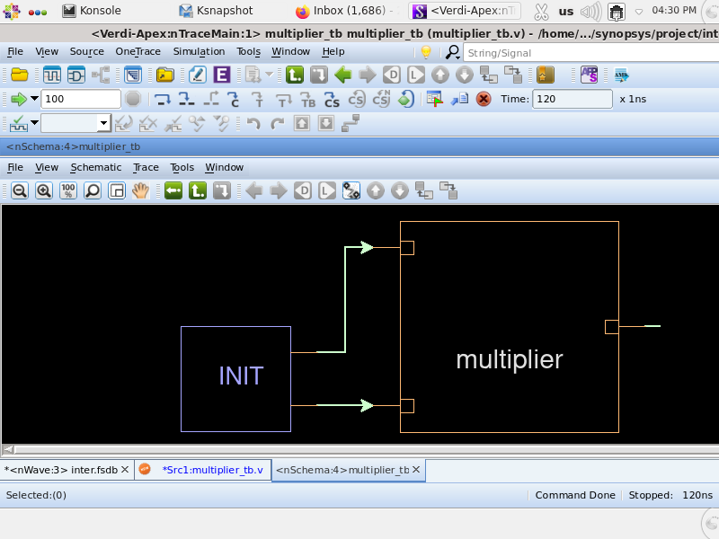
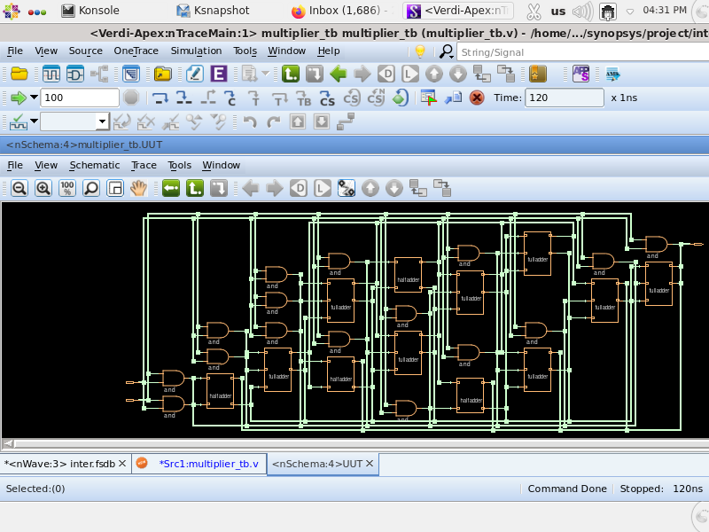
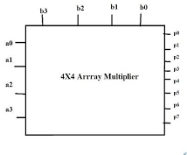
SARA Day
September 19, 2024 | Online
RTL Designing and Testing Of 4x4 Array Multiplier
Title (short title)
BVRIT HYDERABAD College of Engineering for Women
22WH1A0401 – M. Sai Vidhitha, 22WH1A0421 – Yalamanchili Gunavardhini, 22WH1A0430 - Kalluri Hansika
Author (s)
Introduction and Motivation
Results
4x4 Array Multiplier
The motivation is to develop a reliable and efficient 4x4 array multiplier using Synopsys tools.
This project aims for precise design, power and area optimization, and seamless integration, ensuring the multiplier's effectiveness in advanced digital systems and real-world applications.
The primary challenge was debugging the code to identify and fix errors that affected the multiplier's accuracy and functionality.
This involved rigorous testing and troubleshooting to ensure correct operation.
Once the code was stable, the focus shifted to optimizing power consumption, minimizing area, and enhancing performance.
Successfully addressing these challenges led to a robust and efficient 4x4 array multiplier, improving its reliability and effectiveness in practical digital systems and ensuring optimal performance and resource utilization.
PSEUDOCODE
A 4x4 array multiplier is a fundamental digital circuit used to multiply two 4-bit binary numbers, producing an 8-bit result.
It plays a crucial role in digital systems where efficient and high-speed arithmetic operations are essential.
The design involves generating partial products by multiplying individual bits and then aligning and summing these products to achieve the final output.
The motivation for this study lies in understanding the basic principles of digital multiplication and exploring its implementation in low-power, area-efficient systems.
This multiplier serves as a building block for more complex arithmetic units in VLSI design.
Start
Input: A[3:0], B[3:0]
Output: Z[7:0]
Z = 0
For i = 0 to 3 do:
For j = 0 to 3 do:
Partial_Product = (A[i] * B[j]) << (i + j)
Z = Z + Partial_Product
End For
End For
Output Z
End
DECIMAL SIMULATED OUTPUT
BLOCK DIAGRAM
4x4 array multiplier project with Synopsys tools and structural design.
Precise RTL coding and testbench verification.
Optimized performance using SDC/TCL files.
Balanced power, area, and efficiency for optimal results.
SCHEMATIC DIAGRAM
PERFORMANCE METRICS
 |  | 32 or 28 nm technology |  |  | 14 nm technology
Tp |  | 10ns | 5ns | 2ns | 10ns | 5ns | 2ns
Slack | m1 | 8.51 | 3.51 | 0.53 | 9.19 | 4.19 | 1.19
 | m2 | 8.54 | 3.54 | 0.56 | 9.20 | 4.20 | 1.20
Pd | Static | 1.0114e + 06 pW | 1.0114e + 06 pW | 1.0114e + 06 pW | 274.7287 pW | 274.7287 pW | 274.7287 pW
 | Dynamic | 4.1540uW | 4.1540uW | 4.1679uW | 0.8979uW | 0.8979uW | 0.8979uW
 | Total | 13.6111uW | 13.6111uW | 13.7039uW | 1.3868uW | 1.3868uW | 1.3868uW
Area |  | 111.727170 | 111.727170 | 111.727170 | 26.106577 | 26.106577 | 26.106577
Method
Conclusion
By utilizing Synopsys tools, the 4x4 array multiplier takes advantage of advanced optimization techniques for speed, area, and power efficiency. The integration of sophisticated design and verification methods ensures reliable performance and robust testing, resulting in a highly efficient and innovative multiplier design.
The optimized design of the multiplier delivers superior performance with reduced power consumption and minimal area. This not only lowers production costs but also enhances adaptability for various applications. The combination of these factors makes your multiplier a highly competitive solution in both high-performance and energy-efficient markets.
Throughout this project, we developed technical skills using Synopsys tools for writing RTL codes, creating testbenches, and scripting synthesis and simulation. We applied SDC constraints and TCL scripting to optimize power, area, and performance, ensuring a reliable and efficient 4x4 multiplier.
FUTURE SCOPE:
Larger Multipliers: Upgrade the design to handle bigger numbers (e.g., 8x8) for more complex calculations.
Power and Area Optimization: Enhance power-saving techniques and reduce the area to make the multiplier more energy-efficient and compact.
System Integration: Adapt the multiplier for use in a variety of digital systems and applications, such as processors and embedded devices.
References
https://www.researchgate.net/figure/A-4x4-array-multiplier_fig11_268435442
https://www.elprocus.com/4x4-array-multiplier-and-its-working/
https://iijsr.com/data/uploads/2ajast-23.pdf
https://youtu.be/q0SzMHSyVy0?si=S_RFHJvPrsV4NrWU

